Slide 1
Hack CPU Logic & Midterm Practice
Hack CPU Logic, Midterm Topics Brainstorm and Practice Problems, Project 6 Overview

Slide 2
Lecture Outline
Hack CPU Logic
Implementation and Operations
CSE 390B Midterm Practice Problems
Midterm Topics Brainstorming
Project 6 Overview
Project Tips and Workflow

Slide 3
Hack CPU Interface Inputs
inM: Value coming from memory
instruction: 16-bit instruction
reset: if 1, reset the program

Slide 4
Hack CPU Interface Outputs
outM: value used to update memory if writeM is 1
writeM: if 1, update value in memory at addressM with outM
addressM: address to read from or write to in memory
pc: address of next instruction to be fetched from memory

Slide 5
Hack CPU Implementation
pc

Slide 6
Hack CPU Implementation
(each "C" symbol represents a control bit)

Slide 7
CPU Operation: Instruction Handling
(each "C" symbol represents a control bit)

Slide 8
CPU Operation: Instruction Handling
@5
0000000000000101
A-instruction

Slide 9
CPU Operation: Instruction Handling
@5
0000000000000101
A-instruction
CPU handling of an A-instruction:
Decodes the instruction into:
op-code
15-bit value
Stores the value in the A-register
Outputs the value (not shown in this diagram)

Slide 10
CPU Operation: Instruction Handling
C-instruction
D=D+1;JMP
1110011111010111

Slide 11
Hack: C-Instructions
Symbolic:
Binary:
dest = comp ; jump
1 1 1 a c1 c2 c3 c4 c5 c6 d1 d2 d3 j1 j2 j3
Family:
C-Instruction
Unused
Comp:
ALU Operation (a bit chooses between A and M)
Dest:
Where to store result
Jump:
Condition for jumping

Slide 12
CPU Operation: Instruction Handling
C-instruction
D=D+1;JMP
1110011111010111
CPU handling of a C-instruction:
Decodes the instruction bits into:
Op-code
ALU control bits
Destination load bits
Jump bits
Routes these bits to their chip-part destinations
The chip-parts (most notably, the ALU) execute the instruction

Slide 13
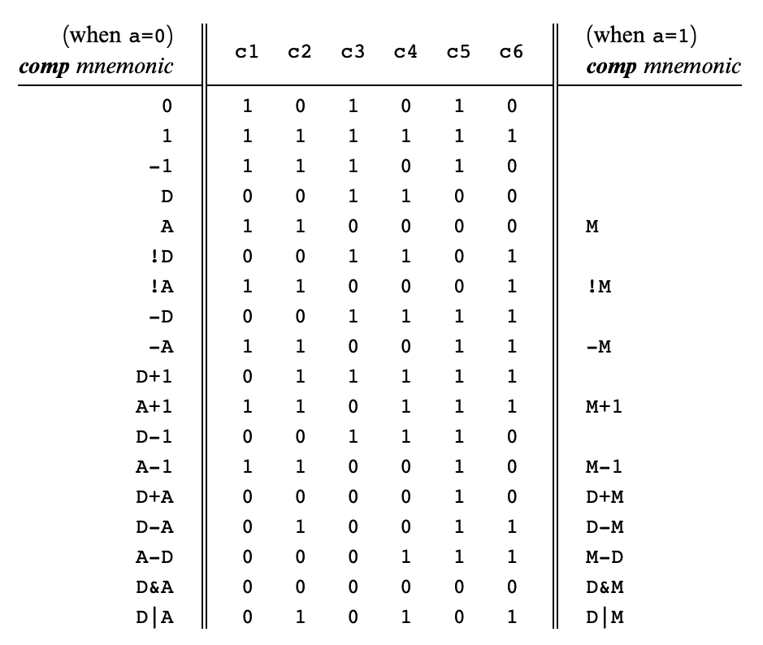
Hack: C-Instructions
Symbolic:
Binary:
dest = comp ; jump
1 1 1 a c1 c2 c3 c4 c5 c6 d1 d2 d3 j1 j2 j3
Comp:
ALU Operation (a bit chooses between A and M)
Chapter 4
Important: just pattern matching text!
Cannot have “1+M”

Slide 14
CPU Operation: Handling C-Instructions
011111
1…01
1110011111010111
1…10
writeM
ALU data inputs:
Input 1: from the D-register
Input 2: from either:
A-register, or
data memory
ALU control inputs:
Control bits (from the instruction)

Slide 15
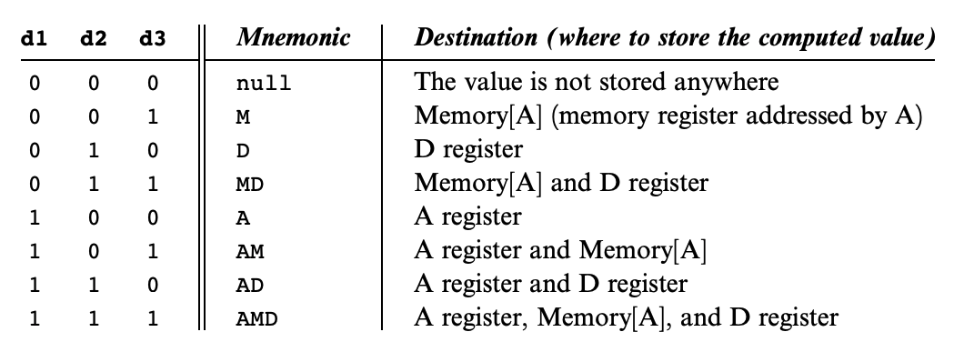
Hack: C-Instructions
Symbolic:
Binary:
dest = comp ; jump
1 1 1 a c1 c2 c3 c4 c5 c6 d1 d2 d3 j1 j2 j3
Dest:
Where to store result
Chapter 4

Slide 16
CPU Operation: Handling C-Instructions
1
011111
0
1…01
0…11
1110011111010111
1…10
writeM
0
ALU data output:
Result of ALU calculation
Fed simultaneously to: D-register, A-register, data memory
Which destination actually commits to the ALU output is determined by the instruction’s destination bits

Slide 17
CPU Operation: Handling C-Instructions
011111
1…01
0…11
1110011111010111
1…10
writeM
ALU control outputs:
Is the output negative?
Is the output zero?

Slide 18
CPU Operation: Control
pc

Slide 19
CPU Operation: Control

Slide 20
CPU Operation: Control
16
load
1
pc
Address of next instruction
PC operation (abstraction)
Outputs the address of the next instruction:
Restart: PC = 0
No jump: PC++
Go to: PC = A
Conditional go to: if (condition) PC = A
else PC ++
16

Slide 21
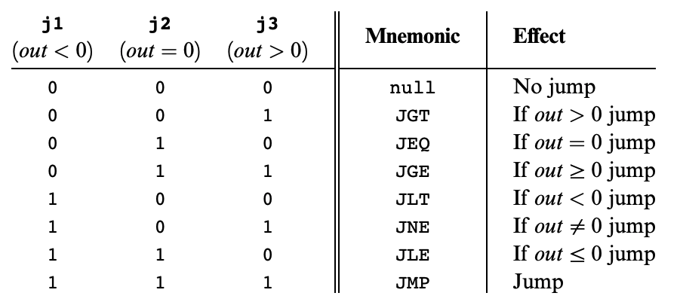
Hack: C-Instructions
Symbolic:
Binary:
dest = comp ; jump
1 1 1 a c1 c2 c3 c4 c5 c6 d1 d2 d3 j1 j2 j3
Jump:
Condition for jumping
Chapter 4

Slide 22
CPU Operation: Control
111 a c c c c c c d d d j j j
16
load
1
pc
Address of next instruction
16
PC operation (implementation)
if (reset==1) PC = 0
else
// In the course of handling the current instruction:
load = f (jump bits, ALU control outputs)
if (load == 1) PC = A // jump
else PC++ // next instruction

Slide 23
Hack CPU Implementation: That’s It!

Slide 24
Lecture Outline
Hack CPU Logic
Implementation and Operations
CSE 390B Midterm Practice Problems
Midterm Topics Brainstorming
Project 6 Overview
Project Tips and Workflow

Slide 25
CSE 390B Midterm Topics Brainstorm
Based on what we have covered so far in class, what are topics, concepts, questions that you might expect to show up on next week’s CSE 390B midterm?

Slide 26
Previous CSE 390B Midterms
Several midterms from previous quarters
20sp midterm likely more difficult than midterm this quarter
Rest of the midterms are more like what this quarter’s midterm will look like
Set a timer for 60 minutes and take the exam in its entirety
Helps practice time management and simulate exam environment

Slide 27
Lecture Outline
Hack CPU Logic
Implementation and Operations
CSE 390B Midterm Practice Problems
Midterm Topics Brainstorming
Project 6 Overview
Project Tips and Workflow

Slide 28
Project 6: Overview
Part I: Mock Exam Problem
Part II: Building a Computer
LoadAReg.hdl, LoadDReg.hdl (Easier)
JumpLogic.hdl (Medium)
CPU.hdl (Harder)
Computer.hdl (Easier)
Part III: Project 6 Reflection

Slide 29
Project 6, Part I: Mock Exam Problem
Your group will meet for a 30-minute session to do one mock exam problem
Your group’s mock exam problem will be emailed right before your session
Your 30-minute session will include:
Set up: 5 minutes
Mock Exam Problem: 10 minutes
Debrief & Reflection: 15 minutes
Part I task: Submit the completed mock exam problem and complete the reflection questions

Slide 30
Project 6 Tips
CPU.hdl: We provide an overview diagram, but there are details to fill in, especially control
Draw your own detailed diagram first
Handling jumps will require a lot of logic—sketch out the cases
Textbook chapter 4 and 5 helpful for Project 6
Multi-Bit Buses: MSB to the left, LSB to the right
Important to keep in mind when taking apart the instruction
Debugging: Consult .out and .cmp files to debug, then look at internal wires in simulator
See also the “Debugging tips” section of the specification

Slide 31
Lecture 10 Reminders
Project 5 due tonight (2/2) at 11:59pm
CSE 390B midterm next Friday (2/9) during lecture
Project 6 (Mock Exam Problem & Building a Computer) released today, due in two Fridays (2/16) at 11:59pm
Eric has office hours after class in CSE2 153
Feel free to post your questions on the Ed board as well

